Slide 1

Recliner Market Analysis
Presented by-
Bhuvana Mandli
Batch No. 493

Slide 2

Agenda
Business Problem
Problem Statement
Project Objective
Project Flow
Dataset Overview
Project steps and screenshots
Business Insights and Recommendations
Conclusion

Slide 3
Business Problem
Customers face difficulty while purchasing recliners because:
Large number of recliner options are available online
Similar recliners have huge price differences
Discounts and EMI offers create confusion
Buyers are unable to identify value-for-money products
Furniture companies also need insights into:
Pricing strategies
Customer preferences
Market trends

Slide 4
Problem Statement
Collect recliner product data from the Pepperfry website using Selenium Web Scraping to analyze pricing patterns, discounts, warranties, and customer preferences.
Perform data preprocessing techniques such as data cleaning, missing value handling, outlier detection, transformation, and feature engineering to prepare the dataset for analysis.
Apply Exploratory Data Analysis (EDA), data visualization, and hypothesis testing to identify the factors influencing recliner prices and generate business insights and recommendations.

Slide 5
Project Objective
Extract recliner data from Pepperfry using Selenium
Perform data preprocessing and feature engineering
Analyze pricing, discounts, and market trends
Identify factors affecting recliner prices
Generate insights using EDA and hypothesis testing
Help customers make better buying decisions

Slide 6
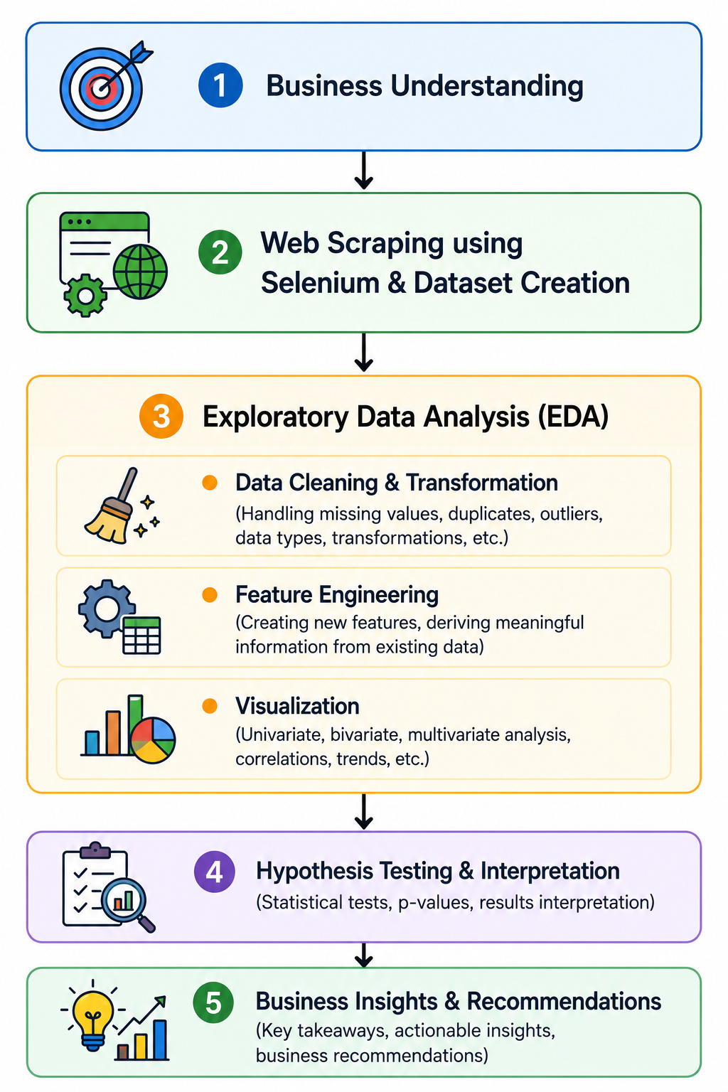
Project Flow

Slide 7
Dataset Overview
Column Name | Description
Brand | Name of the recliner brand/company
Model | Recliner model name
Color | Color variant of the recliner
Seater | Seating capacity of the recliner (1-seater, 2-seater, 3-seater)
Rating | Customer rating given to the recliner
Warranty(Months) | Warranty duration provided by the brand in months
Original Cost | Actual price of the recliner before discount
Discount(%) | Percentage discount offered on the recliner
Final Price | Final selling price after discount
EMI | Monthly EMI amount available for the recliner
Shipping Days | Estimated delivery/shipping time in days
Price Category | Categorized recliner segment based on final price (Budget, Mid-Range, Premium, Luxury)

Slide 8
Project Steps and Screenshots
Data Preprocessing
Checked dataset structure using:
.info()
.describe()
.isnull()
Handled missing values using:
Median, Mean, Mode
Removed duplicate records
Converted columns into proper data types
Detected outliers using:
Z-Score Method
IQR Method

Slide 9
Feature Engineering
New Features Created
1. Discount Amount
Discount Amount = Original Cost - Final Price
Used to analyze actual savings.
2. Warranty(Years)
Warranty(Years) = Warranty(Months) / 12
Improves readability and analysis.
3. Price Category
Products categorized into:
Budget (0–30,000), Mid-Range (30,001–70,000), Premium (70,001–1,50,000), Luxury (1,50,001–3,00,000)
Based on Final Price ranges.

Slide 10
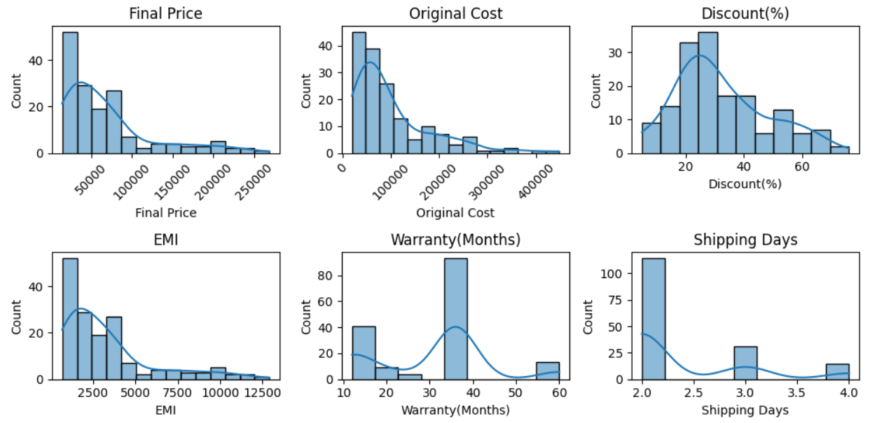
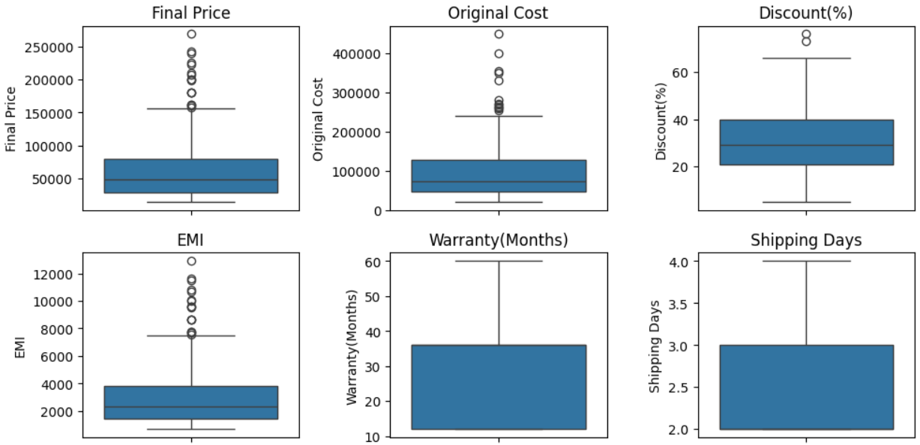
Univariate Analysis
Numerical columns
Key Findings
Most recliners belong to Budget and Mid-Range segments
Price and EMI are highly right-skewed
Majority discounts lie between 20–30%
Most recliners offer 3-year warranty
Shipping time is generally 2–3 days
A few premium recliners and high-discount products appear as upper-end outliers due to luxury branding and promotional offers.

Slide 11
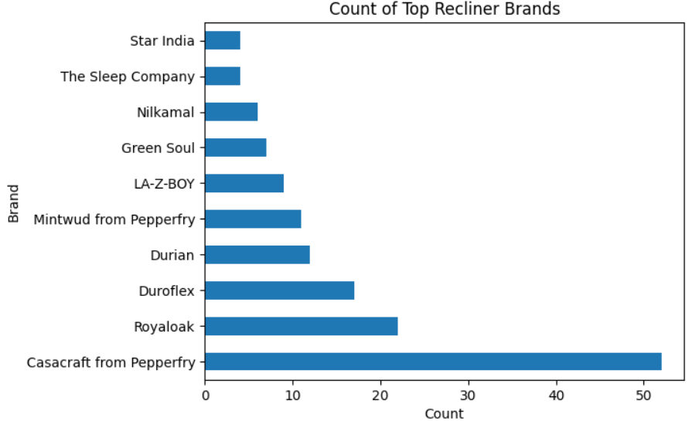
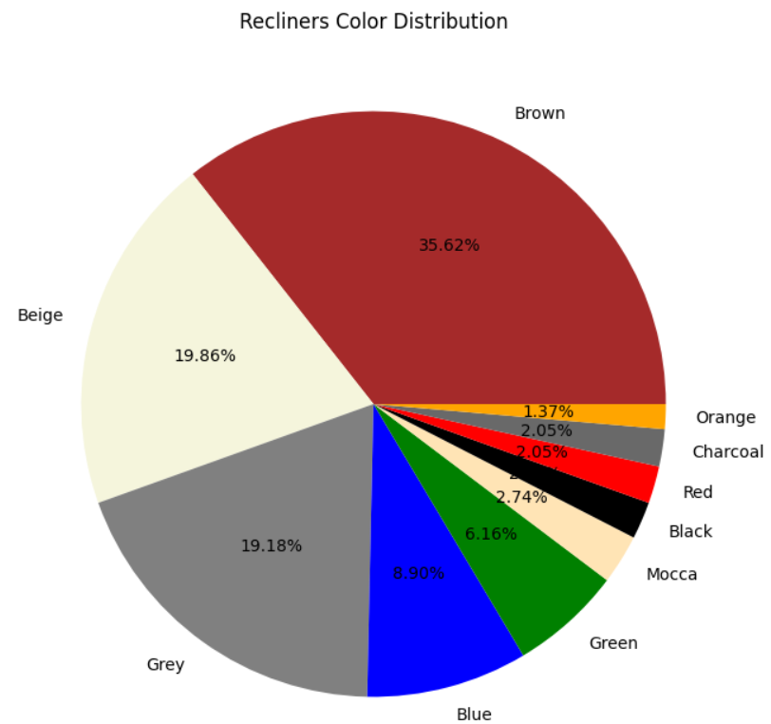
Univariate Analysis
Categorical columns
Top 10 Brands Analysis
Casacraft from Pepperfry dominates the dataset with the highest number of recliner listings.
Color Distribution
Neutral colors such as Brown, Beige, and Grey dominate the recliner market. These colors are likely preferred because they match most interior designs.

Slide 12
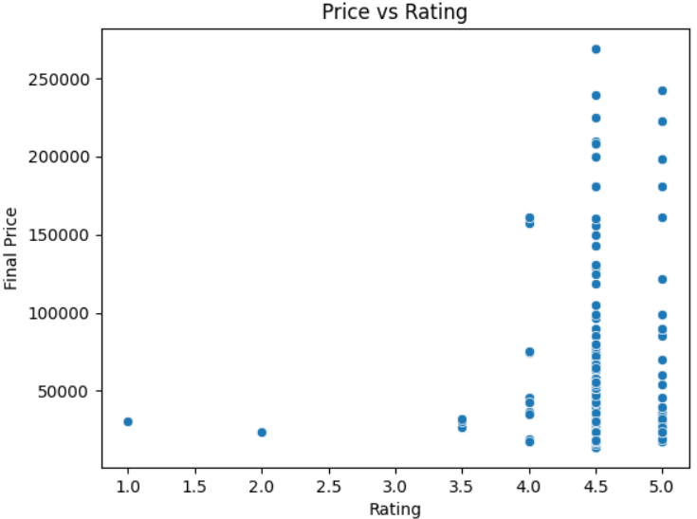
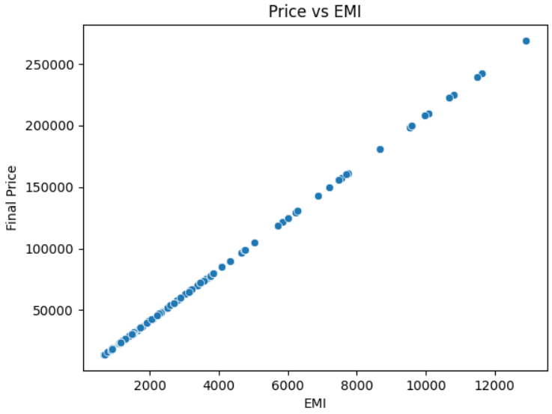
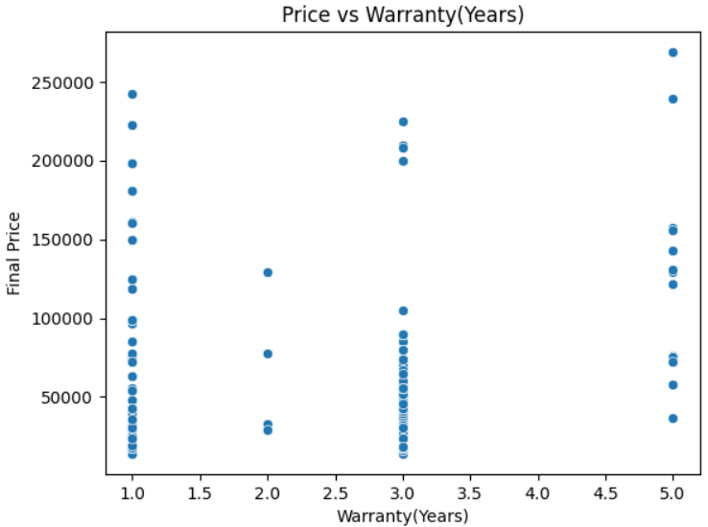
Bivariate Analysis
Numerical vs Numerical
Most recliners have high ratings (4.5–5.0), but ratings do not strongly affect pricing.
Final Price is strongly related to EMI, and recliners with 1–3 year warranties are more common in budget and mid-range categories.

Slide 13
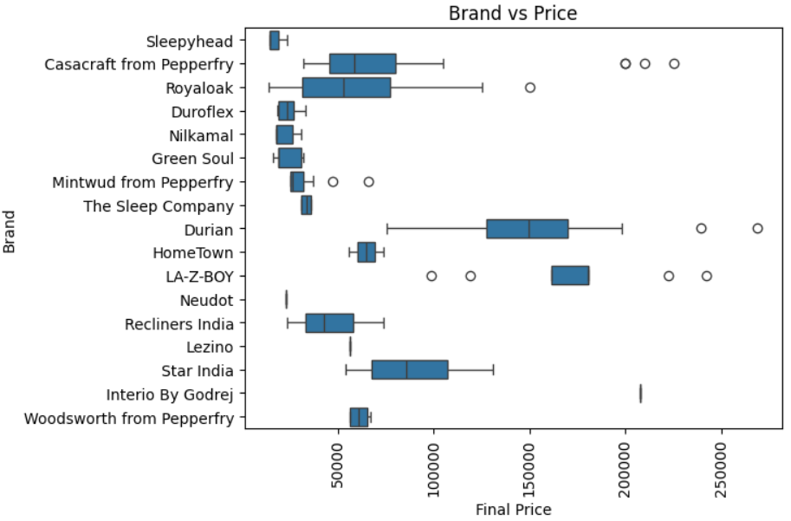
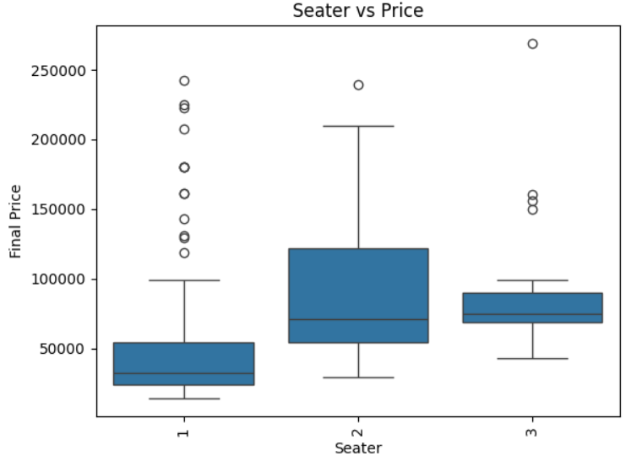
Bivariate Analysis
Categorical vs Numerical
Durian, LA-Z-BOY, and Casacraft from Pepperfry contain several premium-priced recliners. Sleepyhead mainly targets the budget recliner segment.
Although 3-seater recliners generally cost more, several premium luxury recliners are also present in the 1-seater category. This suggests that pricing depends not only on seating capacity but also on brand, material quality, and premium features.

Slide 14
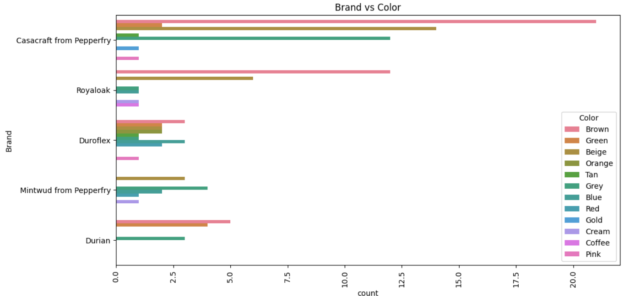
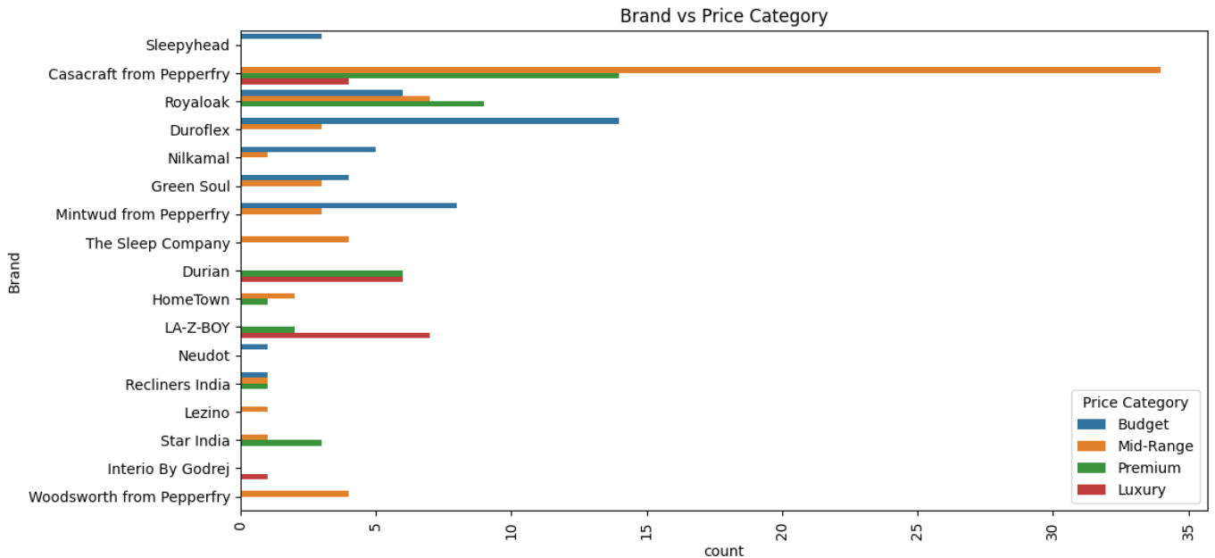
Bivariate Analysis
Categorical vs Categorical
Neutral colors such as Brown and Beige dominate across most recliner brands, while bright colors are comparatively less common in the market.
Most brands mainly focus on Budget and Mid-Range recliners, whereas premium brands offer more Luxury-category recliners, showing clear brand-wise pricing strategies.

Slide 15
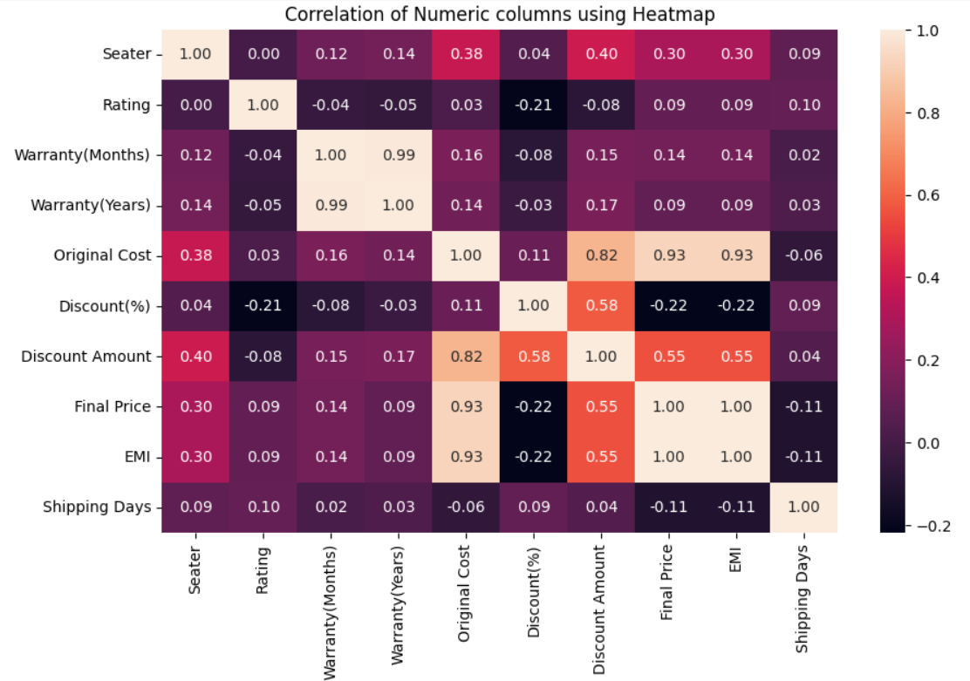
Multivariate Analysis
Strong positive relationship exists between Final Price and EMI.
Original Cost and Final Price also move together.
Discount percentage does not show a perfectly strong relationship with Final Price.

Slide 16
Hypothesis Testing
Do brands affect recliner pricing?
Null Hypothesis(H₀): Brand has no impact on price.
Alternate Hypothesis(H₁): Brand significantly affects price.
Brand(Categorical) vs Final Price(Numerical) - ANOVA Test
Result: Reject H₀ (p < alpha)
Conclusion: Brand significantly affects recliner pricing.
Premium brands such as Durian, Casacraft from Pepperfry and LA-Z-BOY contain higher-priced recliners. Some brands mainly target budget and mid-range customers.
Does seating capacity affect recliner price?
Null Hypothesis(H₀): Seater capacity has no impact on price.
Alternate Hypothesis(H₁): Seater capacity significantly affects price.
Seater(Assume Categorical) vs Final Price(Numerical) - ANOVA Test
Result: Reject H₀ (p < alpha)
Conclusion: Multi-seater recliners generally cost more. But there are single seater recliners which cost more.

Slide 17
Hypothesis Testing
Is discount related to final price?
Null Hypothesis(H₀): No relationship exists between discount and final price.
Alternate Hypothesis(H₁): Discount significantly relates to final price.
Discount(Numerical) vs Final Price(Numerical) - Pearson Correlation Test
Result: Reject H₀ (p < alpha)
Conclusion:
Discount percentage significantly relates to recliner pricing.
Higher-priced recliners tend to receive larger discounts.
Brands may use discounts as a strategy to attract buyers toward premium recliners.

Slide 18
Business Insights and Recommendations
Business Insights
Premium brands dominate luxury recliner market
EMI strongly depends on recliner pricing
Neutral colors are highly preferred
Budget and Mid-Range recliners dominate the market
Most brands focus on Budget and Mid-Range recliners, while premium brands mainly target the Luxury segment.
Recommendations
For Customers
Mid-range recliners provide better value-for-money
Customers should compare warranty and discount together before purchasing
For Businesses
Focus more on neutral-colored recliners
EMI-based marketing can attract premium buyers
Competitive warranty can improve product positioning

Slide 19
Conclusion
Successfully scraped recliner data from Pepperfry using Selenium
Performed complete data preprocessing and feature engineering
Conducted detailed EDA and visualization
Identified important pricing patterns and market trends
Validated findings using hypothesis testing
Generated meaningful business insights and recommendation
The project demonstrates how Web Scraping + EDA can help understand online furniture market behavior and support data-driven decision making.

Slide 20


Slide 21


